Slide 1
Parameter considered during motor claim approval process
Category | Parameters
Policy Details | Policy number, type, coverage, validity.
Claimant Information | Claimant name, relationship, contact details.
Type of Claim | Own Damage , Third Party , Comprehensive
Incident Details | Date, time, location, nature of incident, police report.
Vehicle Details | Registration number, make, model, year, engine/chassis number.
Damage Assessment | Extent of damage, repair estimates, surveyor report.
Driver Details | Driver’s license, history.
Documentation | Claim Form , Driving License: , RC Book , FIR , Repair estimate / bill , Claim amount, deductibles, previous claims.
Medical Reports | Injury details, medical bills.
Assessment of Damages | Extent of Damage, Repair Cost , Total Loss Evaluation, Depreciation
Fraud Detection | Red flags, investigation.
Legal and Compliance | Regulatory compliance, court cases.
Approval Workflow | Approval hierarchy, audit trail.

Slide 2
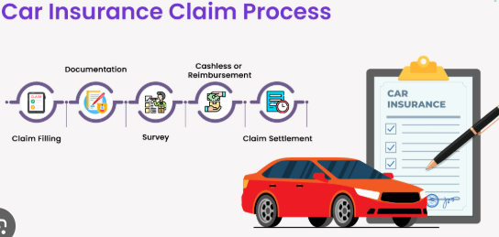
Parameter considered during motor claim approval process

Slide 3
Automation using AI
Generate Structured Data Sets: Create structured data from claims reports to speed up the claims processing.
Validate Claims Using External Data: Use external data sources, such as weather reports, to validate claims and reduce the costs associated with incorrect evaluations.
Recommend Templates for Incoming Claims: Use historical data on similar claims to recommend templates for new claims, making the process more efficient.
Chatbot Interface for Claims Reporting: Implement a chatbot that uses natural language processing and historical claims data to improve the efficiency of claims reporting.
Automatic Text Production from Speech Claims: Automatically generate text from phone call recordings, including emotions and behavior analysis, to enhance efficiency.
Define Damage Severity from Photos: Use photos submitted by customers to assess the severity of damage, improving the speed and convenience of claims processing.
Generate Automatic Claim Reports: Automatically produce claim reports based on structured data to optimize the workload for employees.

